Slide 1


UNIT-2
IoT and M2M Communication & IoT Platform Design Methodology
Lavanya Santhosh Dept. of CSE Dr.AIT, Bengaluru

Slide 2
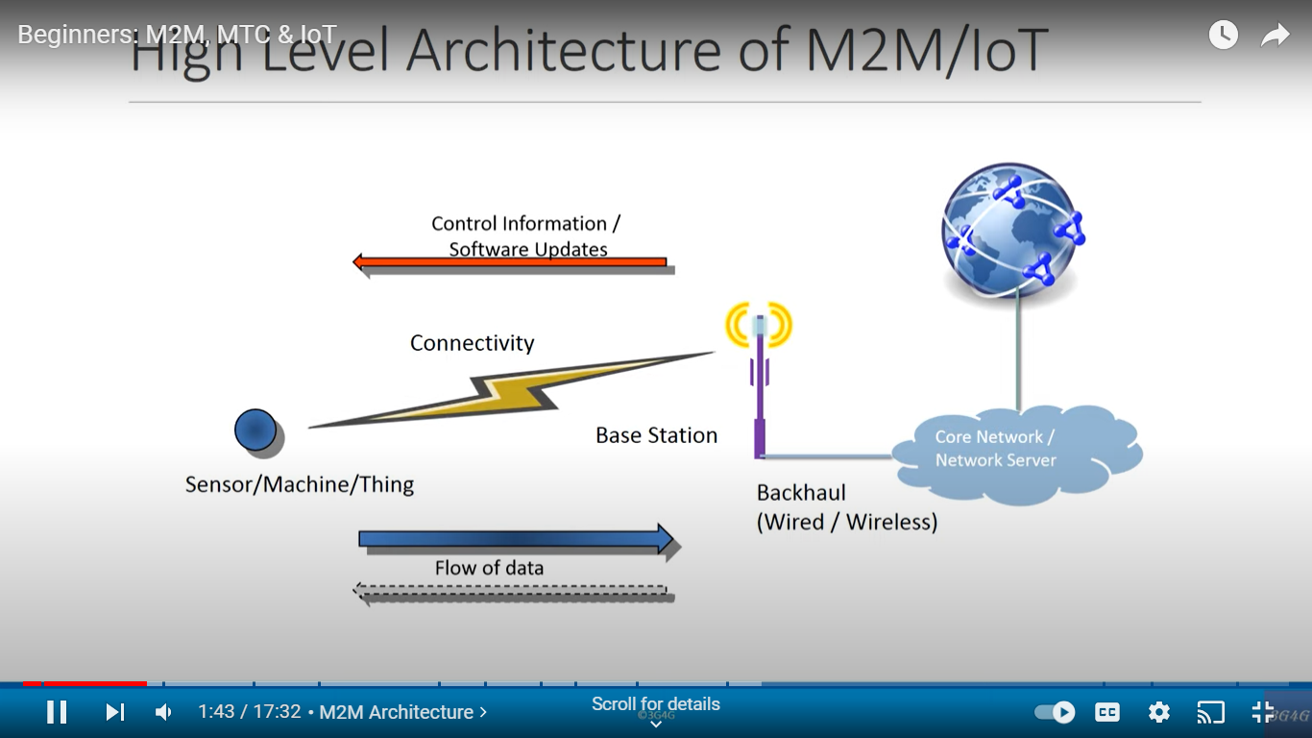
High Level Architecture of M2M/ IoT

Slide 3
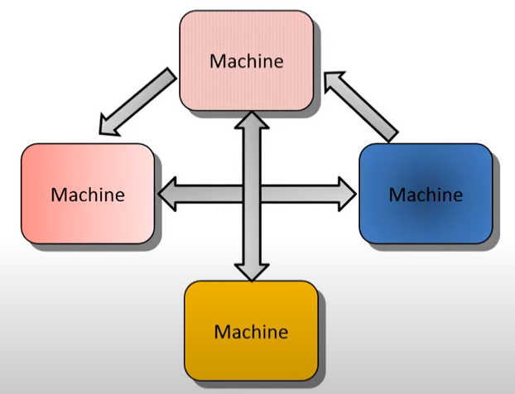
MACHINE-TO-MACHINE (M2M)

Slide 4
MACHINE-TO-MACHINE (M2M)
Machine-to-Machine (M2M) refers to networking of machines or devices for the purpose of remote monitoring and control and data exchange.
Time Tolerance
Low Mobility
Scheduled
Low on power consumption.
Packet switched

Slide 5
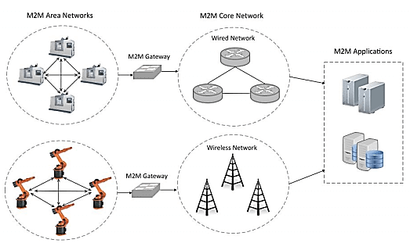
M2M System Architecture

Slide 6
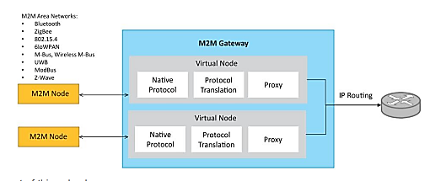
Block Diagram of M2M Gateway
The communication between M2M nodes and the M2M gateway is based on the communication protocols which are native to the M2M are network.
M2M gateway performs protocol translations to enable IP-connectivity for M2M are networks.
M2M gateway acts as a proxy performing translations from/to native protocols to/from Internet Protocol(IP).
With an M2M gateway, each node in an M2M area network appears as a virtualized node for external M2M area networks.

Slide 7
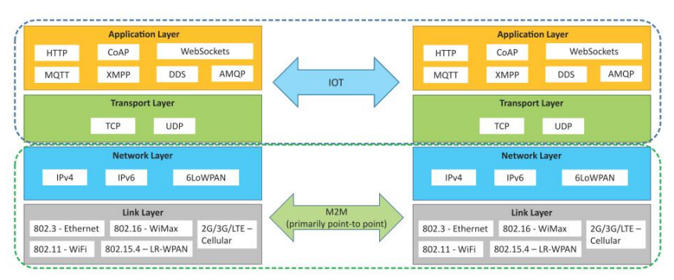
Communication Protocols of M2M and IoT

Slide 8
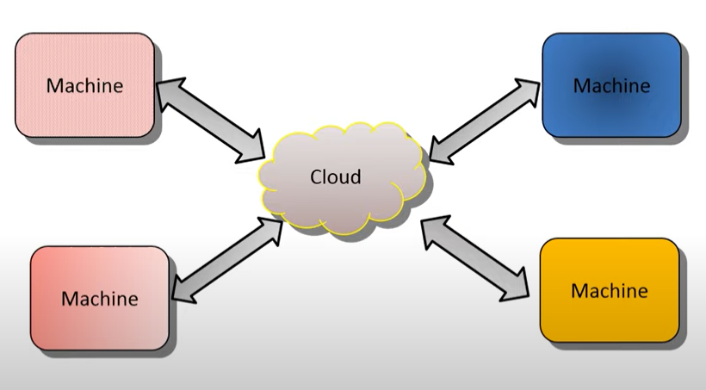
I o T

Slide 9
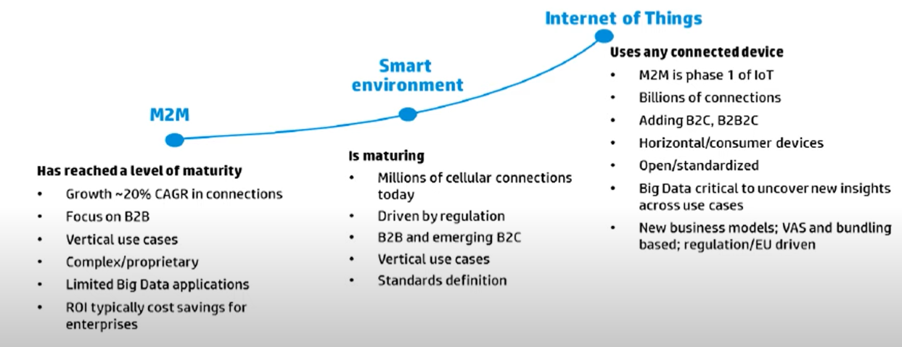
M2M evolution to IoT

Slide 10
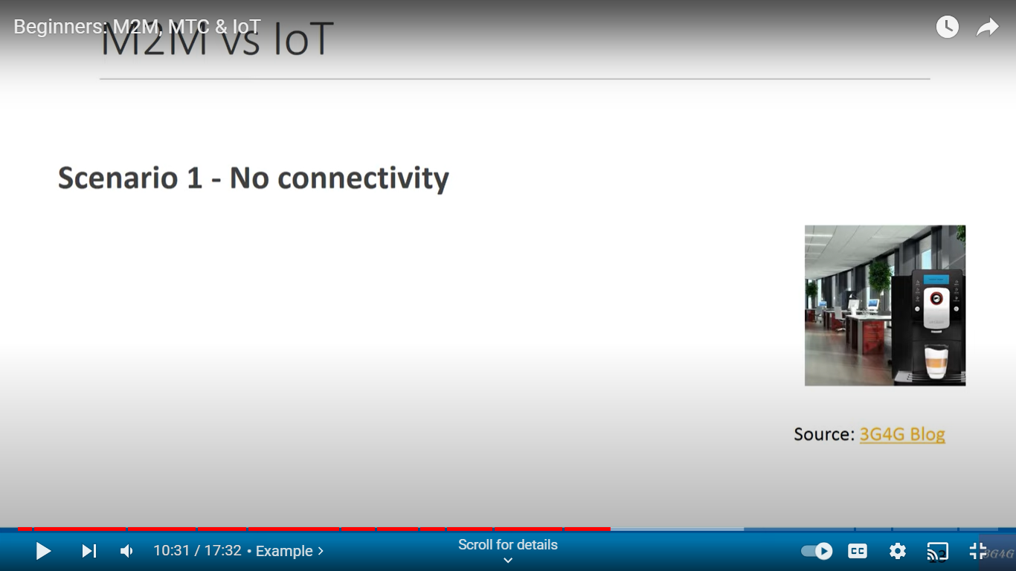
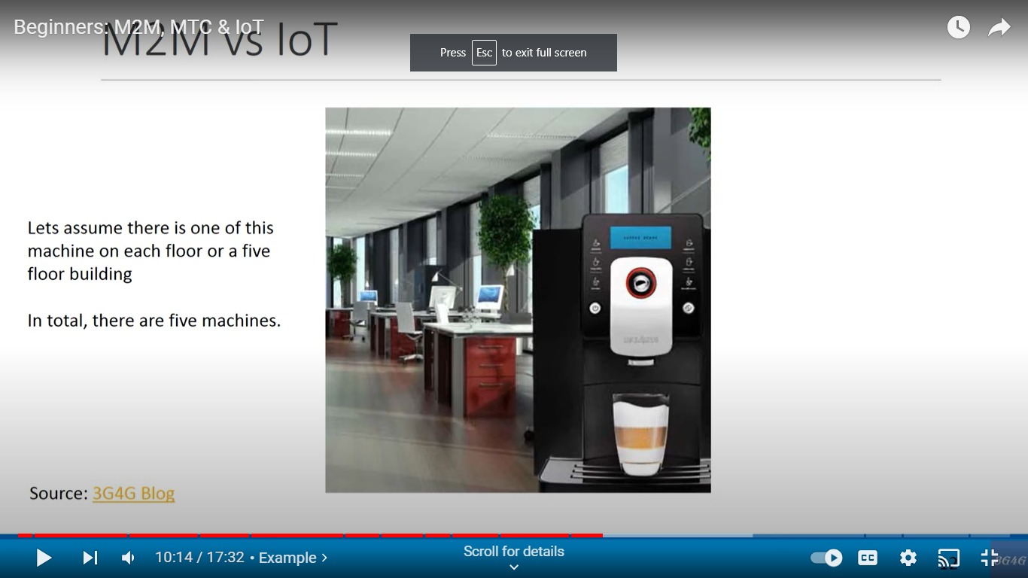
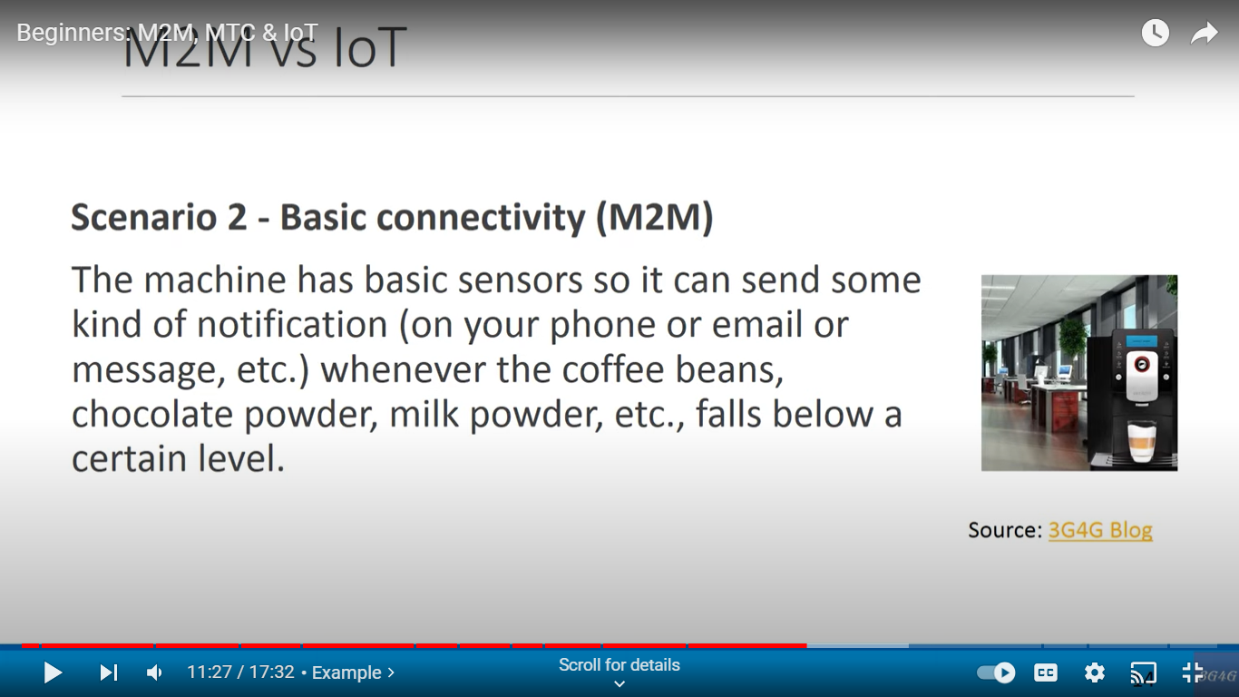
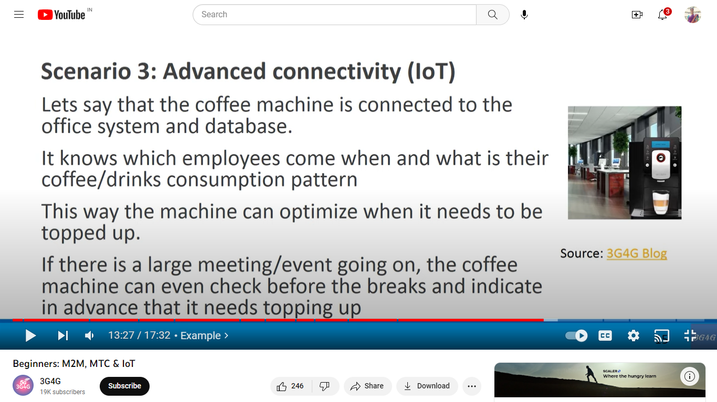
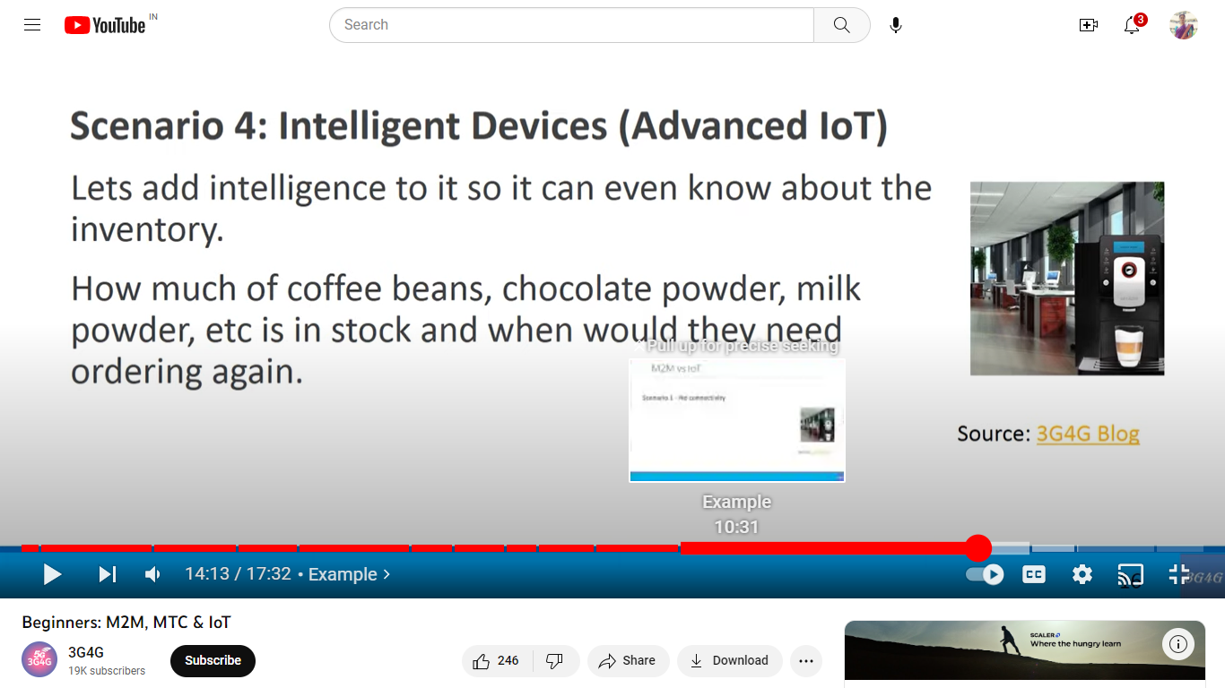
M2M and IoT

Slide 11
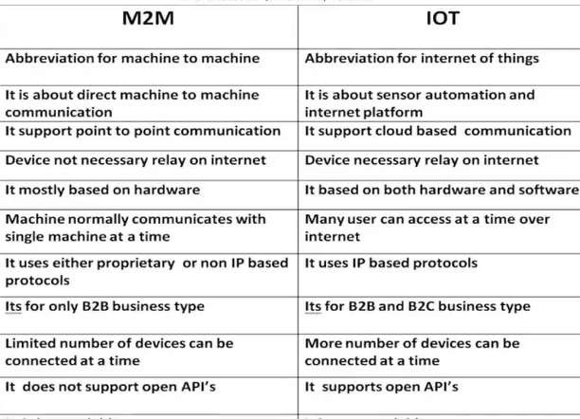
DIFFERENCE BETWEEN M2M AND IOT

Slide 12
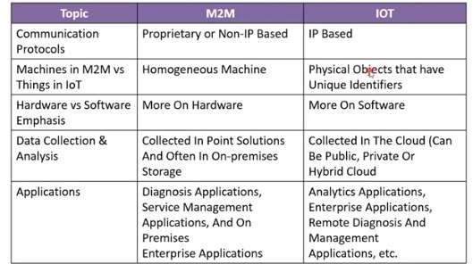
DIFFERENCE BETWEEN M2M AND IOT

Slide 13
MCQ’s
1. M2M is mostly ___________
a) Hardware centric
b) Software centric
c) Both
d) None
2. The relation between IoT and M2M is ___________
a) IoT is part of M2M
b) M2M is the part of IoT
c) Both are same
d) None
3. The communication network in M2M can be used ___________
a) Wireless medium
b) Wired medium
c) Both
d) None

Slide 14
MCQ’s
4. M2M applications would use ___________ for storage and analysis
a) Cloud
b) Local Machine
c) Both
d) None
5. Mostly M2M network performs ___________ communication
a) One to many
b) Broadcast
c) One to one
d) Multicast
6. To enable the communication between remote M2M area networks ___________ devices are used.
a) Senosrs
b) Routers
c) Switches
d) Gateways

Slide 15
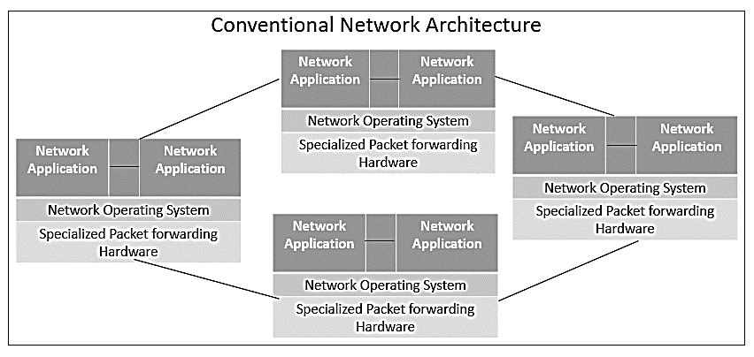
Conventional Network Architecture
Network devices in conventional n/w architectures are getting exceedingly complex with the increasing number of distributed protocol being implemented and the use of proprietary h/w and interfaces.

Slide 16
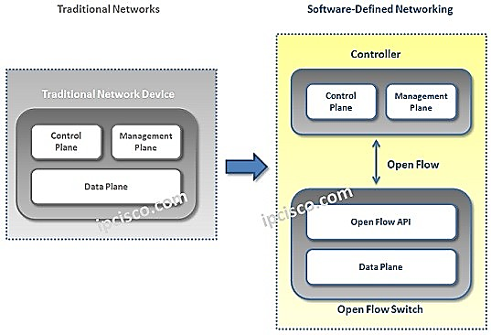
Software Defined Networking - SDN
Limitation of CSDN
Complex Network Device.
Management overhead.
Limited scalability.

Slide 17
Software Defined Networking - SDN
SDN is a networking architecture that separates the control plane from the Data plane and centralizes the network controller.
SDN Simplifies data communication in N/W.
SDN maintains a unified view of the configuration, Management and provisioning simpler.
Architecture which aims to improve overall network performance and make networks agile and flexible by enabling a dynamic and programmatically efficient network configuration.
SDN is a technology that separates control plane management of network devices from underlying data plane that forwards network traffic in order to enable more automated provisioning and policy-based management of network resources.

Slide 18
Components of SDN
SDN Application: Relay requests or networks through SDN controller using API.
SDN Controller: Collects network information from hardware and sends this information to applications.
SDN Networking Device: Helps in forwarding and data processing tasks.

Slide 19
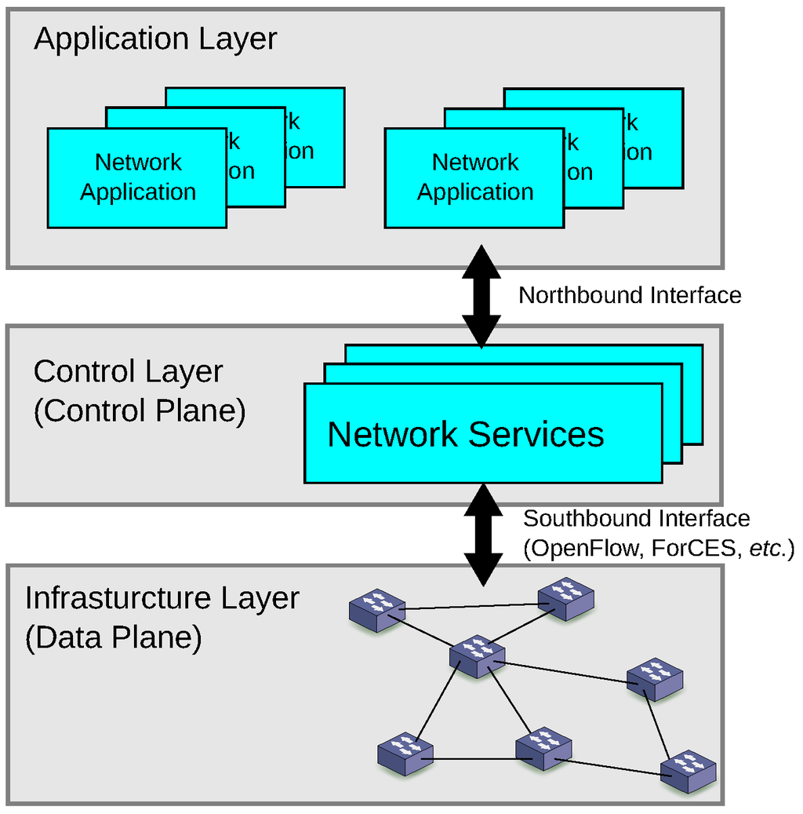
SDN Architecture

Slide 20
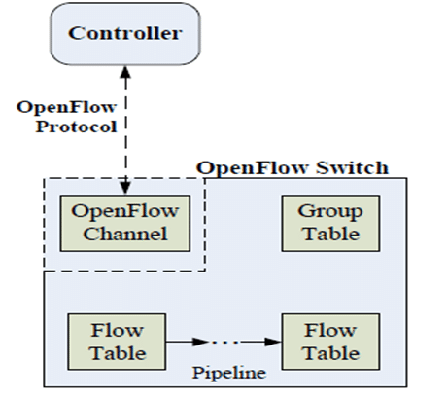
Key Elements of SDN
Centralized Network Controller
Programmable Open APIs
Standard Communication Interface (OpenFlow)
Defined by Open Networking Foundation (ONF).
Broadly accepted protocol for southbound interface.
With OF, the forwarding plane of the n/w devices can be directly accessed and manipulated.
Uses the concept of flows.
Flows can be programmed.
OpenFlow protocol is implemented on both sides of the interface b/w the controller and the network devices.
Controller manages the OF switch via OF protocol.
Controller can add, update and delete flow entries in flow table.
OpenFlow Switch

Slide 21
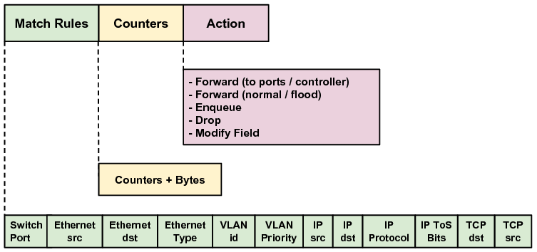
Example of OpenFlow flow Table
Each flow table contains a set of flow entries.
Each flow entry consists of match fields, counters and set of instructions to apply matching packets.
Matching starts at the first flow table and may continue to additional flow tables of the pipeline.

Slide 22
Software Defined Networking - SDN
Advantages:
Centralized Controller
Faster scaling & Deployment
Lower Hardware cost
Disadvantages:
Increased Complexity
Single point of failure.
Lesser Traditional Networking jobs.

Slide 23
Network Functions Virtualization NFV
Technology that leverages virtualization to consolidate the heterogeneous network devices onto Industry standard high volume servers, switches and storage.
Complimentary to SDN and provides infrastructure on which SDN can run.
Mutually beneficial to each other, but not dependent.
NFV comprises of Network functions implemented in s/w that run on virtualized resources in the cloud.
NFV enables separation of n/w functions which are implemented in s/w from the underlying h/w.
VNF reduces the equipment costs and also reduces power consumption.
NFV is applicable only to data plane and control plane functions in fixed and mobile networks.

Slide 24
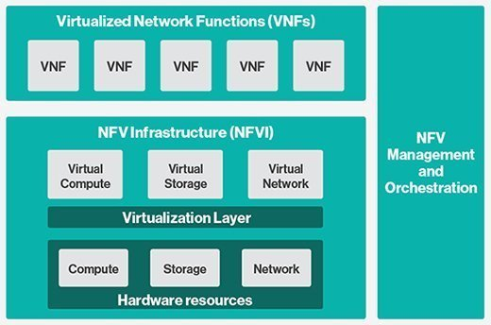
Network Functions Virtualization NFV
Standardized by European Telecommunication Standards Institute (ETSI).
Key elements of NFV architecture are
Virtualized Network Function: S/w implementation of a n/w function which is capable of running over the NFV Infrastructure (NFVI). Eg: VFirewall, VRouter etc.
NFVI: Includes Computer, n/w and storage resources that are visualized.
NFV Management & Orchestration: Focuses on all virtualization-specific management tasks and covers the orchestration and life cycle management of physical and s/w resources that support the infrastructure virtualization and life cycle management of VNF’s

Slide 25
SDN & NFV for IoT
SDN | NFV
SDN architecture mainly focuses on data centers. | NFV is targeted at service providers or operators.
SDN separates control plane and data forwarding plane by centralizing control and programmability of network. | NFV helps service providers or operators to virtualize functions like load balancing, routing, and policy management by transferring network functions from dedicated appliances to virtual servers.
SDN uses OpenFlow as a communication protocol. | There is no protocol determined yet for NFV.
SDN supports Open Networking Foundation. | NFV is driven by ETSI NFV Working group.
Various enterprise networking software and hardware vendors are initiative supporters of SDN. | Telecom service providers or operators are prime initiative supporters of NFV.
Corporate IT act as a Business initiator for SDN. | Service providers or operators act as a Business initiator for NFV.
SDN applications run on industry-standard servers or switches. | NFV applications run on industry-standard servers.
SDN reduces cost of network because now there is no need of expensive switches & routers. | NFV increases scalability and agility as well as speed up time-to-market as it dynamically allot hardware a level of capacity to network functions needed at a particular time.
Application of SDN: Networking Cloud orchestration | Application of NFV: Routers, firewalls, gateways WAN accelerators SLA assurance Video Servers Content Delivery Networks (CDN)

